Slide 1

QuizNia
“Do The Best You Can…”

Slide 2

Online Quiz Project Presentation
MEERUT COLLEGE, MEERUT
(CS DEPARTMENT)
SUBMITTED BY:
KRATIKA (ROLL NO. 200619121065)
PRINCE PANWAR (ROLL NO. 200619121089)
SHIVANGI SINGH (ROLL NO. 200619121112)
SHRUTI (ROLL NO. 200619121115)
SUBMITTED TO:
Mrs. SURBHI SAROHA
(ASSISTANT PROFESSOR)

Slide 3




INTRODUCTION
Introducing QuizNia: A test of knowledge to achieve your goals.
The name QuizNia is a combination of word Quiz ( i.e. Test of Knowledge )
and Nia ( i.e. Goal ).
It is a user-friendly online quiz web app which allows learners to take quizzes
and check their knowledge and competency.
This quiz website provide a great platform for practice and solving queries
by taking feedback from the user which is having a great user interface.
The proposed work in this field are available on internet in huge amount
like; many website are available for playing quizzes online and query solving
for the user
This website provide large varieties of questions (Big Domain).
This website provides content blogs for concept revision.
Here’s what you need to know about QuizNia……

Slide 4


OVERVIEW:
QuizNia is designed to provide an engaging and effective learning experience
for all learners.
With QuizNia you can take quizzes on any topic, from Science to Mathematics, English etc.
It offers variety of features to enhance learning, allowing you to practice anytime, anywhere at your own pace.
There will be a limited number of questions and for each correct answer
user will be get a credit score.
To develop a user friendly application, our web application will contain:
Number of quiz .
Answer to every question.
Feedback

Slide 5



KEY FEATURES
PERSONALIZED LEARNING: QuizNia provides a personalized learning experience that adapts to your skill level and interests. It provides you flexibility to learn anywhere, anytime at your own pace.
USER-FRIENDLY INTERFACE: QuizNia has a simple and user-friendly interface that makes it easy to navigate and interact with the web app. Our home page provides an intuitive layout, featured subjects such as English, Science, Mathematics etc.
ACCESSIBLE ON ALL DEVICES: QuizNia is accessible on all devices and platforms, including desktop, mobile, and tablet. This means that you can learn and practice anytime, anywhere and take your learning with you on the go.

Slide 6
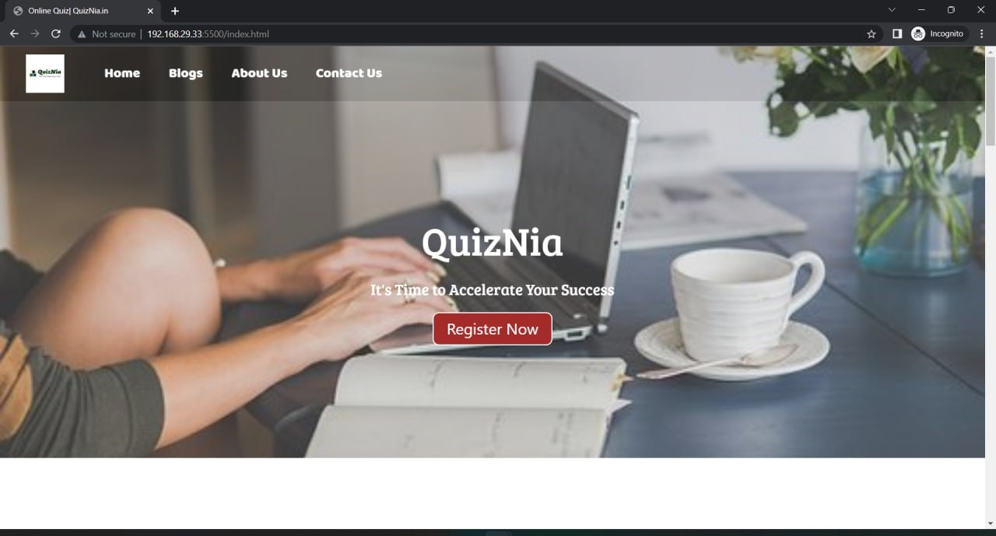
WORK SAMPLE
HOME

Slide 7
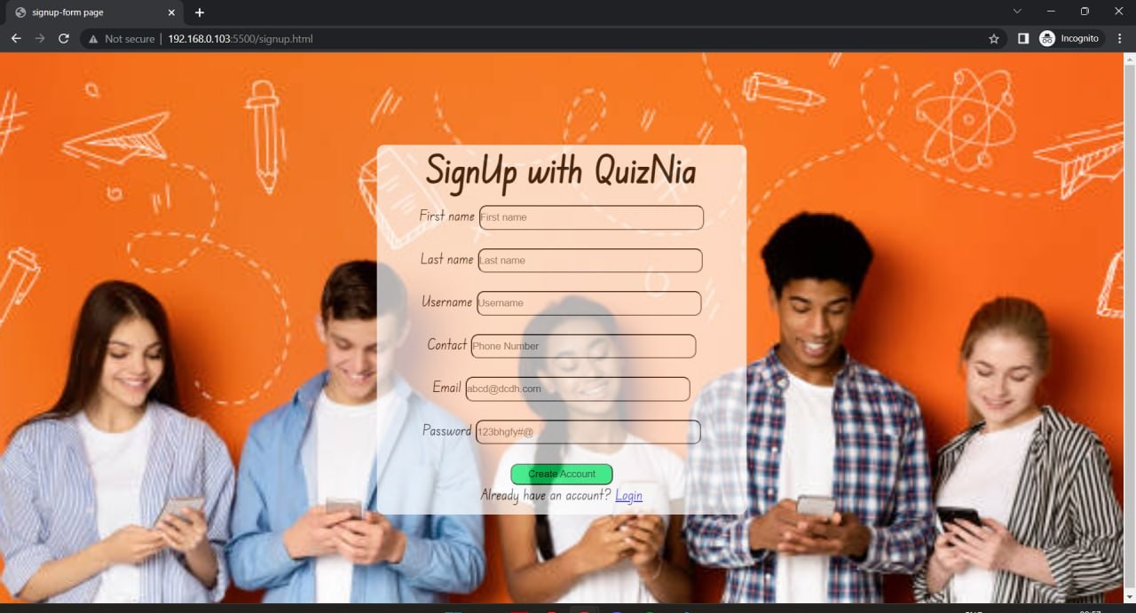
SIGNUP PAGE

Slide 8
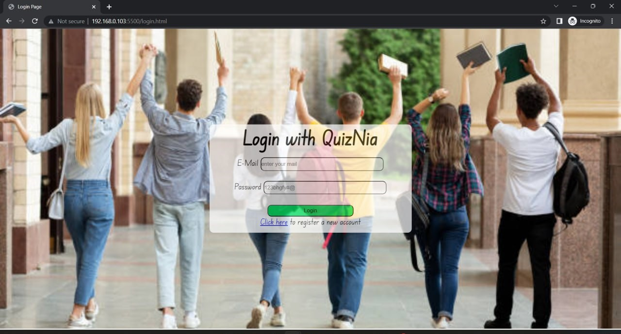
LOGIN PAGE

Slide 9
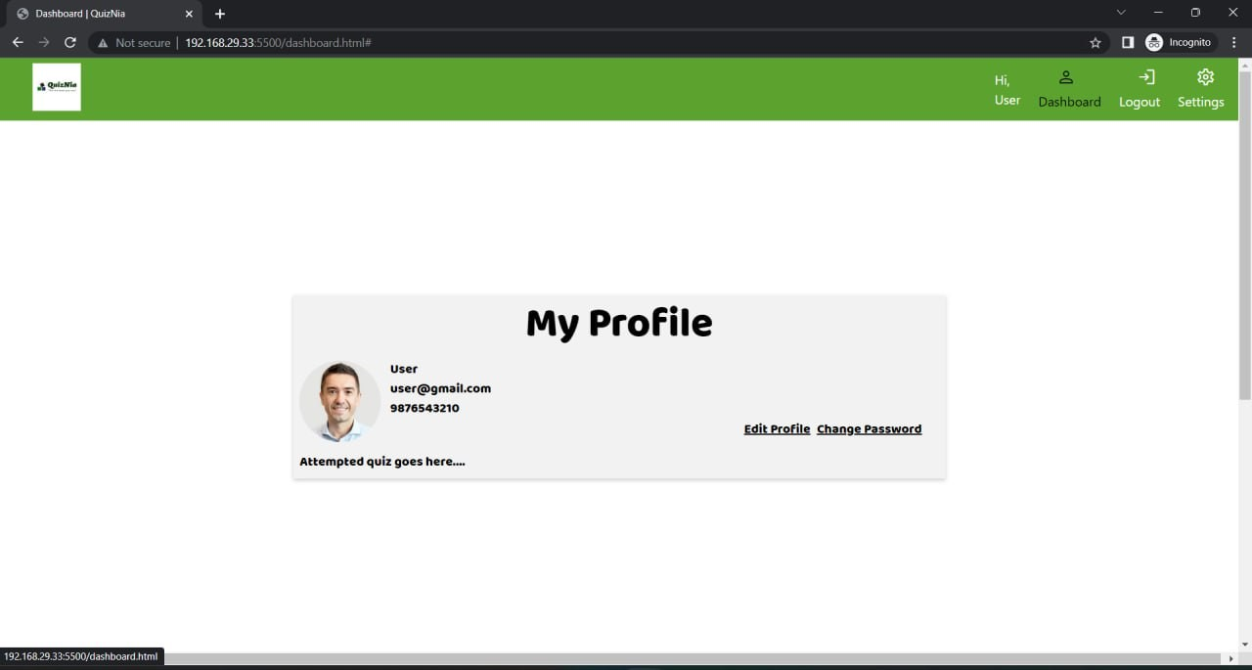
DASHBOARD

Slide 10
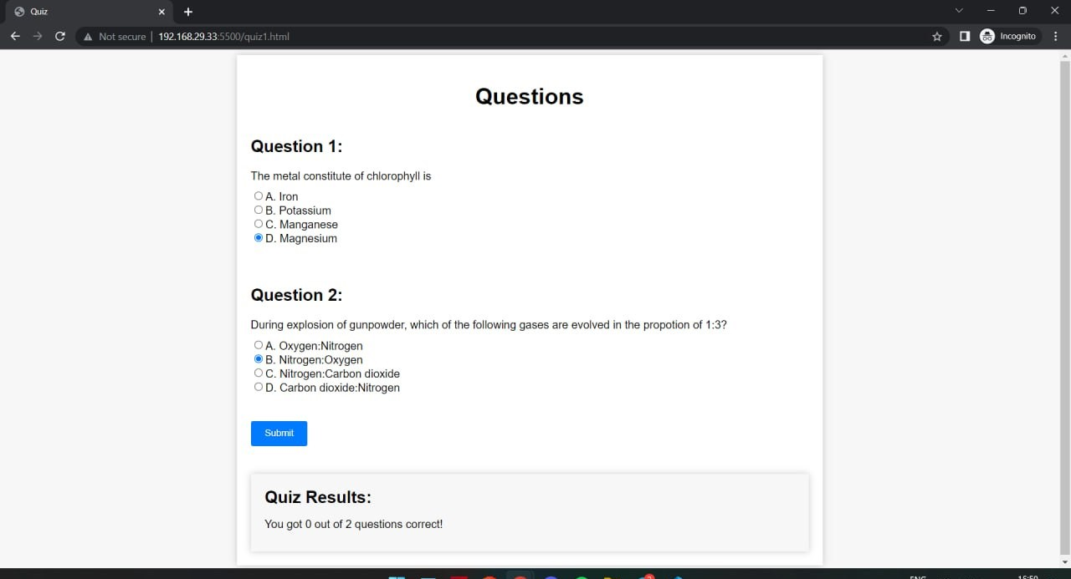
QUIZ SAMPLE

Slide 11
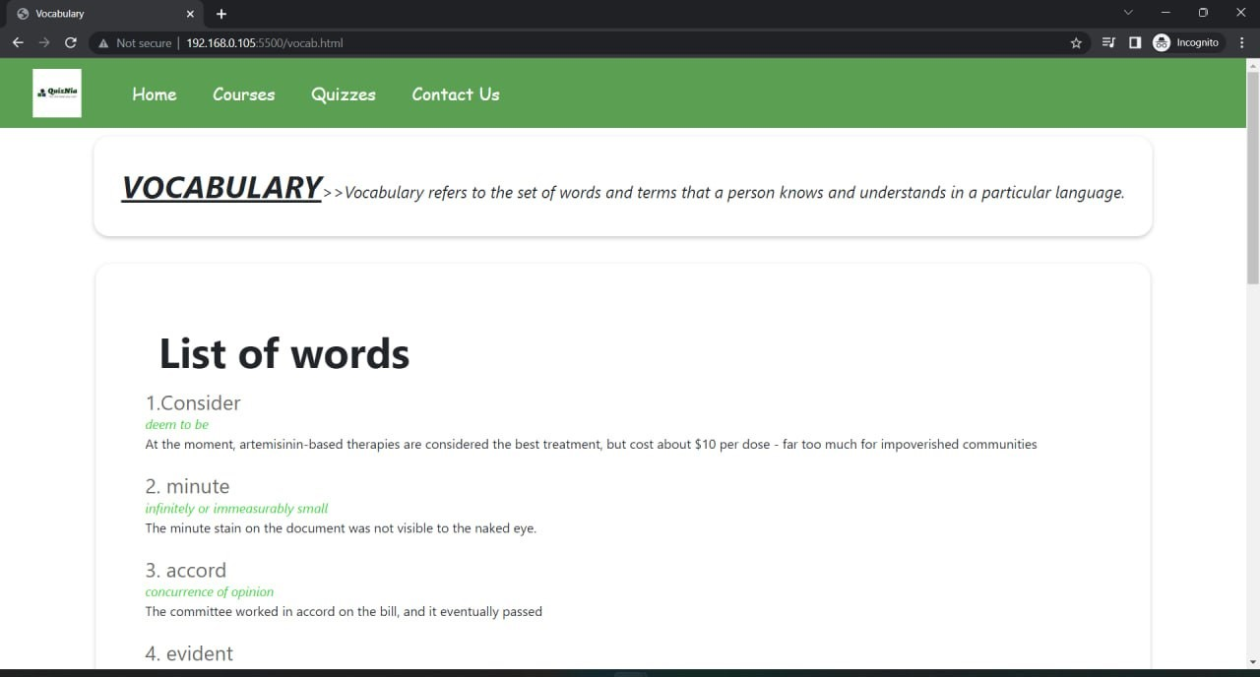
BLOG SAMPLE

Slide 12
ER DIAGRAM
email
user_
name
last_
name
password
user_id
first_
name
register
contact
user_
name
user
Has to
login
password
could attempt
attempt_id
time_
limit
quiz_id
user_id
status
Has
started_
time
quizzes
Quiz
attempt
quiz_id
ended_
time
name
selected_id
Made of
question_id
score
is_
correct
Question answer
User
answer
is_
multiple
attempt_id
answer_
text
question_id
quiz question
answer_
id
answer_
id
question_id
quiz_id
question_answer
question_time

Slide 13
DFD
LEVEL 0
Online Quiz Web App
User
management
Register
Show user info
Quiz
management
login
Generate response
Select quiz topic
Quiz info
Show quiz
Create/edit/delete quiz
Take quiz
Check answer
Show Result
Result

Slide 14
LEVEL 1 FOR USER MANAGEMENT
Register
User
registration
Show user info
User management
Generate id/password
User_table
Get id/password
Check id/password
Enter id/password
Confirm login
Login
process
Show result
Take quiz
Start quizzing
Result
Result after taking quiz

Slide 15
LEVEL 1 FOR QUIZ MANAGEMENT
Select quiz topic
Choose topic/subject
Take quiz
Quiz_table
Start quizzing
Update quiz
Quiz_question
Result
Create/edit/
delete quiz
Quiz management
Question for quiz
Quiz_attempt
Attempt
Attempt quiz
Answer by user
User_answer
Check answer
Question_answer
Correct answer

Slide 16
PURPOSE AND BENEFITS
EMPOWER LEARNER THROUGH INTERACTIVE QUIZZING....
QuizNia is designed with a mission to provide a better learning experience for all learners.
Determined to help all learners to enhance their knowledge through interactive quiz with concept.
User benefit:
Learning: Quizzes are designed to teach users about a variety of topics including from Science to History, Mathematics etc.
Self-assessment: Quizzes can be used to assess user’s knowledge or understanding of a particular topic. This can be a valuable tool for personal growth and development, as users can identify in which area of knowledge they are lagging behind and need improvement.
Challenge: By participating in quizzes on various topics users can feel a sense of accomplishment when they complete them successfully.

Slide 17
FUTURE SCOPE
THE FUTURE IS NOW: Advanced quiz technology for smarter learning.
PERSONALIZATION: A quiz web app can be personalized to suit the user preferences and needs. This can include customized quiz content, recommendations based on quiz results, and personalized learning paths.
GAMIFICATION: A quiz web app can incorporate game elements, such as points, levels, and rewards, to enhance user engagement and motivation. This can make learning and self-improvement more fun and enjoyable for users.
INTEGRATION OF CHATBOTS: A quiz web app can integrate chatbots which are AI powered tools that can simulate conversations with users and provide personalized support and assistance. By integrating chatbots into quiz web app, users can receive real-time feedback and assistance about their problems, making the using and learning process more efficient, effective and easy.

Slide 18
INTEGRATION WITH SOCIAL MEDIA: A quiz web app can be integrated with social media platforms, allowing user to share quiz results with their friends and compete with each other. This can help to increase user engagement and expand the reach the app.
VOICE ASSISTANTS: A quiz web app can be integrated with voice assistants such as Alexa and Google Assistant, allowing user to interact with quiz content through voice commands. For instance, user could ask the voice assistant to start a quiz, answer questions, and provide feedback.
MOBILE APP: A quiz web app can be developed as a mobile app, allowing users to access quiz content on the go.

Slide 19
TEAM QuizNia
GET TO KNOW THE PEOPLE BEHIND QuizNia
Our team is made up of passionate members who are committed to creating the best online quiz web app for learners.
Team QuizNia is a group of “4” members viz/namely “Shruti, Shivangi Singh, Prince Panwar, Kratika ….”
Our team is dedicated to creating a high-quality and user-friendly product that meets needs of our users.
With a focus on innovation, user experience and quality, team QuizNia is dedicated to help learners succeed in their journey.

Slide 20
CONCLUSION
TRY QuizNia TODAY AND TRANSFORM YOUR LEARNING EXPERIENCE…..
With a dedicated team of developers it provides a user friendly, engaging and effective learning experience that helps learners to achieve their goals.
RECAP: Here we have explored the key features, purpose, benefits and team behind the QuizNia. We have shown how QuizNia makes it easy for learners to take quizzes on any topic and how it provides reporting to track progress and performance.
CALL TO ACTION: If you’re looking for a powerful and user-friendly online quiz web app that can transform your learning experience, then we invite you to try “QuizNia” today. With range of topics and quizzes QuizNia is a good choice for learners everywhere.
CONTACT INFORMATION: If you have any questions or feedback about QuizNia, please don’t hesitate to contact us. You can reach us by email, phone, or social media, and we’ll be happy to help you in any way we can.

Slide 21


THANK YOU

